Slide 1
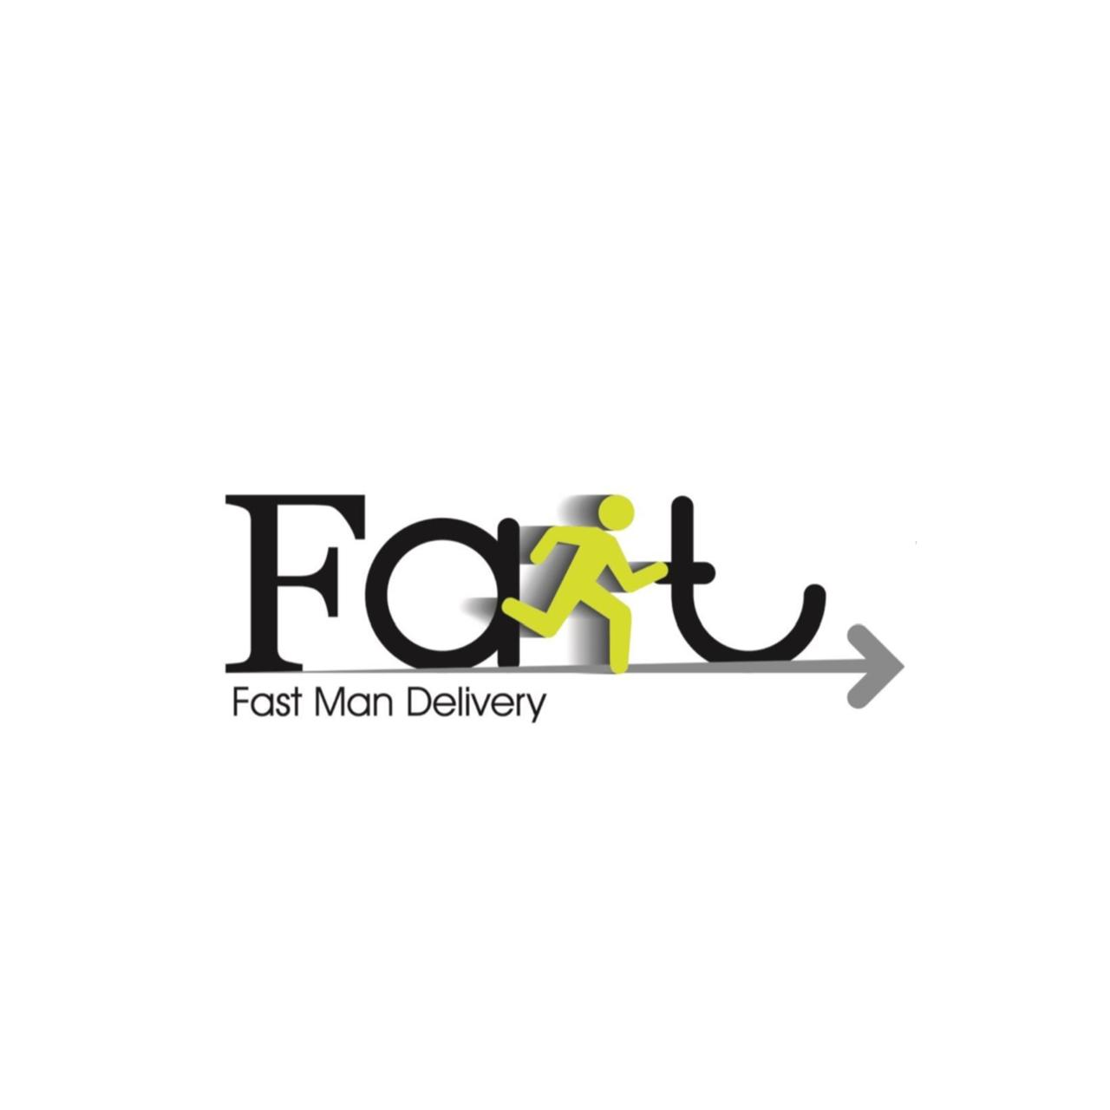
Smart Logistics Intelligence System for Delivery Optimization & Risk Prediction
Dania Ibrahim Alqaisi, Halla Alaa Eddin Awad, & Rakan Al Saied Obaid

Slide 2
Delivery & Logistics Analytics System This project uses Business Intelligence and AI techniques to analyze delivery performance, delays, returns, customer risk, and operational efficiency. The project combines: Power BI dashboards KNIME analytics workflows Machine Learning models Customer segmentation techniques
Project Overview

Slide 3

Problem Fast Man Company faces challenges related to delivery delays, returned orders, revenue loss, and identifying high-risk deliveries. Manual monitoring makes it difficult to detect patterns and improve operational performance. Objectives - Analyze delivery performance, delays, returns, and revenue. - Monitor driver and regional performance. - Predict delivery risks and returned orders using Machine Learning. - Segment deliveries into meaningful groups using K-Means clustering. - Support data-driven decision-making through interactive Power BI dashboards. Goal Develop a Smart Logistics Intelligence System that improves delivery efficiency, reduces operational risks, and supports better business decisions.
Project Problem & Objectives

Slide 4
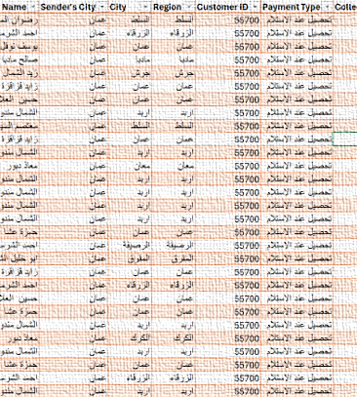
Dataset Overview The dataset used in this project was provided by Fast Man Company in Jordan and contains real logistics and delivery operation records. It includes information related to orders, customers, drivers, delivery status, return status, delivery attempts, payment methods, revenue, delivery fees, booking dates, delivery dates, and failure reasons. During the preprocessing phase, additional variables such as Delivery Delay, Scheduled Days, Actual Delivery Days, Is Late, and Is Returned were created to support analysis and machine learning modeling. The dataset served as the foundation for evaluating delivery performance, identifying operational risks, predicting delivery outcomes, and developing business intelligence dashboards to support data-driven decision-making.
4

Slide 5
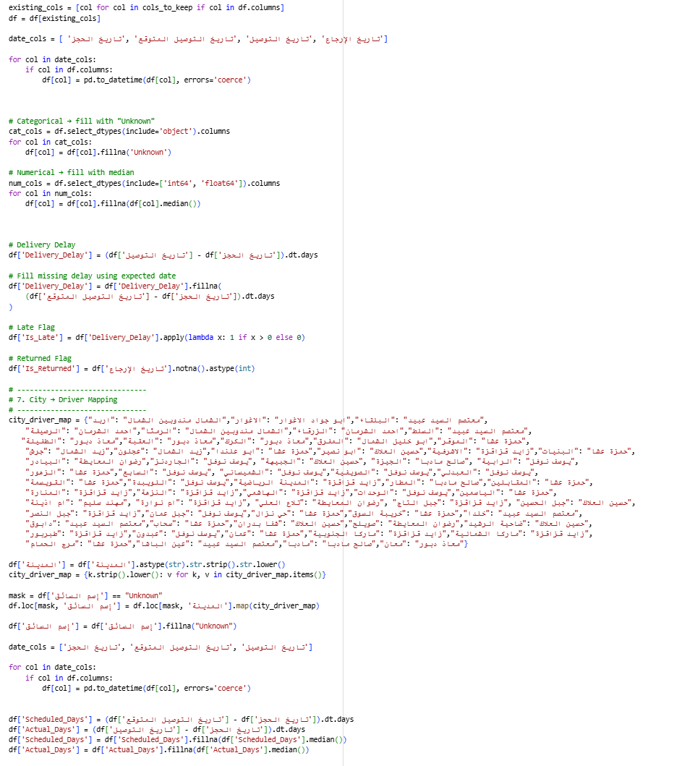
Data Cleansing
Data cleaning and preprocessing were performed to improve data quality and prepare the dataset for analysis. Missing values were handled, date columns were converted to the correct format, and text fields were standardized to remove inconsistencies. Additional features such as Delivery Delay, Scheduled Days, Actual Days, Is Late, and Is Returned were created to support analysis and prediction. Driver information was also completed using city-based mapping. These steps ensured the dataset was accurate, consistent, and ready for Business Intelligence dashboards, machine learning models, and clustering analysis.
5

Slide 6
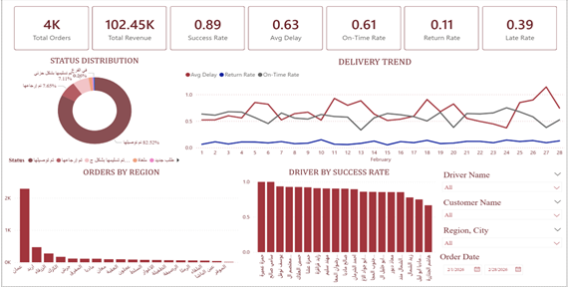
Operations Performance Dashboard Overview The Operations Performance Dashboard provides a high-level view of Fast Man’s delivery operations. It summarizes key performance indicators such as total orders, total revenue, success rate, average delay, on-time delivery rate, return rate, and late delivery rate. The dashboard also analyzes order status distribution, delivery performance trends over time, regional order volumes, and driver success rates. These insights help management monitor operational efficiency, evaluate delivery performance, and identify areas requiring improvement.
6

Slide 7
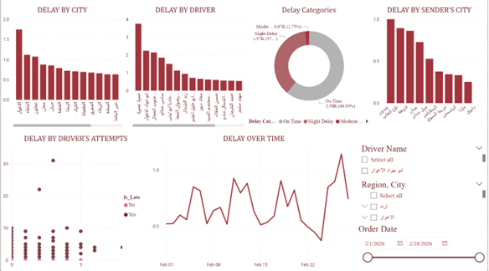
Delay Analysis Dashboard Overview The Delay Analysis Dashboard focuses on understanding delivery delays across different operational dimensions. It analyzes delays by city, driver, sender location, delivery attempts, and time. The dashboard also categorizes delays into on-time, slight delay, and moderate delay groups to highlight the severity of delivery issues. By identifying the regions, drivers, and routes with the highest delays, the dashboard supports efforts to optimize delivery operations, reduce late shipments, and improve customer satisfaction.
7

Slide 8
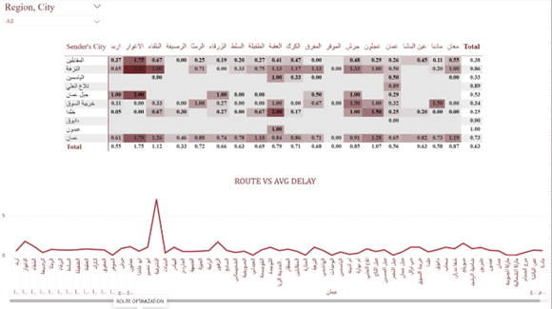
Route Optimization Dashboard Overview The Route Optimization Dashboard analyzes delivery performance across different sender and destination cities. It uses a heatmap to highlight average delivery delays between routes and a trend chart to compare routes based on their delay levels. This dashboard helps identify inefficient delivery routes, detect areas with recurring delays, and support route planning decisions that improve delivery speed and operational efficiency.
8

Slide 9
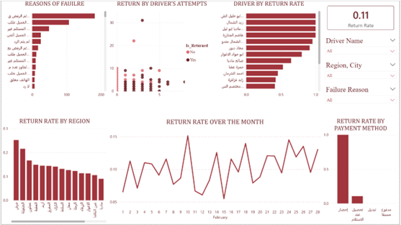
Return Analysis Dashboard Overview The Return Analysis Dashboard focuses on understanding returned orders and failed deliveries. It analyzes the main reasons for delivery failure, return rates by region, driver return performance, delivery attempts, payment methods, and return trends over time. These insights help the company identify the root causes of returns, reduce failed deliveries, improve customer communication, and minimize revenue losses associated with returned orders.
9

Slide 10
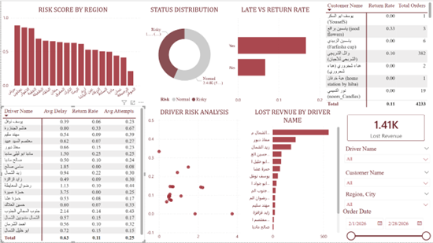
Risk Analysis Dashboard Overview The Risk Analysis Dashboard evaluates operational risks by combining return rates, delivery delays, customer behavior, and financial impact. It includes risk scores by region, status distribution, late versus return rate analysis, driver risk assessment, lost revenue by driver, and customer-level risk metrics. This dashboard helps management identify high-risk regions, customers, and drivers, allowing proactive actions to reduce losses, improve delivery performance, and enhance overall operational reliability.
10

Slide 11
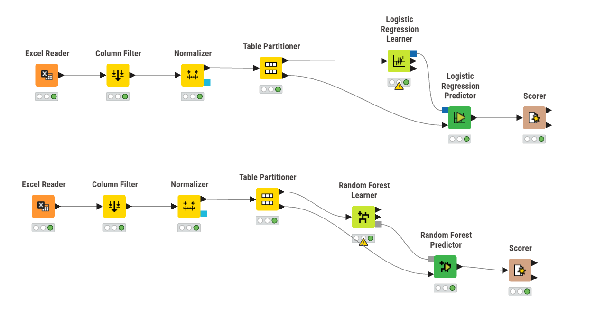
The prediction models were developed in KNIME to forecast delivery outcomes. The dataset was loaded, relevant features were selected, and numerical values were normalized. The data was then split into training and testing sets using the Table Partitioner. Two models, Logistic Regression and Random Forest, were trained and used to generate predictions on the test data. Finally, the Scorer node evaluated model performance using metrics such as accuracy, precision, recall, and F-measure. Random Forest achieved the best overall performance.
Prediction Process

Slide 12
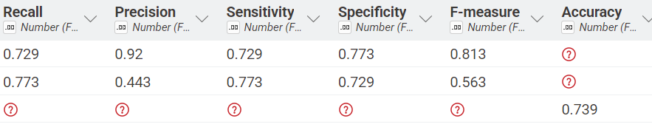
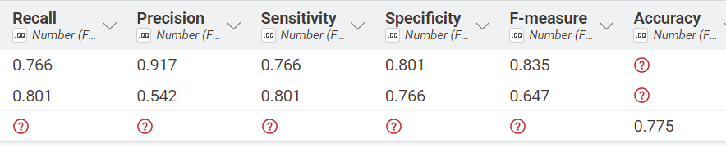
Logistic Regression Results: Accuracy: 73.9% Precision: 92.0% Recall (Sensitivity): 72.9% Specificity: 77.3% F-Measure: 81.3% Explanation: Logistic Regression achieved strong precision, meaning it was very effective at correctly identifying customers who would respond positively to the campaign. However, its overall accuracy and recall were lower than Random Forest, indicating that some potential responders were missed. Random Forest Results Accuracy: 77.5% Precision: 91.7% Recall (Sensitivity): 76.6% Specificity: 80.1% F-Measure: 83.5% Explanation: Random Forest achieved higher accuracy, recall, specificity, and F-measure compared to Logistic Regression. This indicates a better overall ability to correctly classify both responding and non-responding customers while reducing prediction errors. Winning Model: Random Forest Highest accuracy (77.5%) Better recall and specificity Highest F-measure (83.5%) More effective at capturing complex customer behavior patterns Business Impact: Random Forest provides more reliable customer response predictions, helping businesses improve campaign targeting, reduce marketing costs, and increase conversion rates.
12

Slide 13
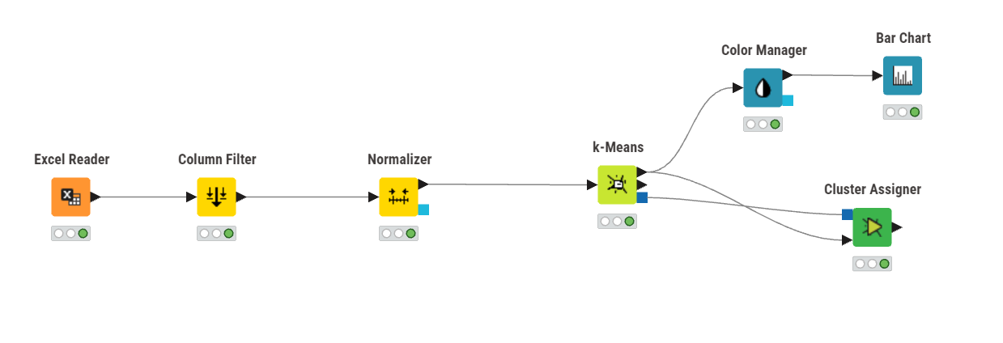
The clustering model was developed in KNIME using the K-Means algorithm to group similar deliveries based on their characteristics. The dataset was loaded using the Excel Reader, relevant variables were selected through the Column Filter, and numerical values were standardized using the Normalizer. The K-Means node then analyzed the data and divided records into distinct clusters based on similarity patterns. The Cluster Assigner assigned each record to its corresponding cluster, while the Color Manager and Bar Chart were used to visualize the cluster distribution. This process helped identify different delivery behavior groups and supported targeted operational strategies.
Clustering Analysis

Slide 14
Cluster 2 – Stable Deliveries (2,407)
Largest cluster with low delays and low return rates
Represents normal and efficient delivery operations
Strategy:
Maintain service quality
Focus on customer retention
Improve efficiency through automation and route optimization
Cluster 1 – Moderate Risk Deliveries (1,379)
Moderate delays and increased delivery risk
Requires closer operational monitoring
Strategy:
Improve route planning
Monitor driver performance
Enhance customer communication for delays
Cluster 0 – High Risk Deliveries (447)
High delays, multiple delivery attempts, and higher return rates
Most critical delivery segment
Strategy:
Assign experienced drivers
Prioritize monitoring and risk alerts
Improve address validation and customer confirmation
14

Slide 15

Overall Business Use: This project helps Fast Man Company improve delivery operations through Business Intelligence and Artificial Intelligence techniques. The dashboards provide real-time monitoring of delivery performance, delays, returns, and operational risks. The prediction models identify deliveries that are likely to face issues, allowing proactive actions before problems occur. Clustering segments deliveries into low-, medium-, and high-risk groups, enabling targeted operational strategies. Together, these insights help reduce delays and returns, improve customer satisfaction, optimize resource allocation, minimize revenue loss, and support data-driven decision-making.

Slide 16
Thank you

